Slide 1
CSE477
VLSI Digital Circuits
Fall 2002
Lecture 15&16: Dynamic CMOS
Mary Jane Irwin ( www.cse.psu.edu/~mji ) www.cse.psu.edu/~cg477
[Adapted from Rabaey’s Digital Integrated Circuits, ©2002, J. Rabaey et al.]
Notes:
May want to reduce this to one lecture (but with 42 slides it may not be possible).
If covered after the midterm, could fill up the “extra” time in two lectures going over the midterm exam.

Slide 2
Review: Designing Fast CMOS Gates
Transistor sizing
Progressive transistor sizing
  fet closest to the output is smallest of series fets
Transistor ordering
  put latest arriving signal closest to the output
Logic structure reordering
  replace large fan-in gates with smaller fan-in gate network
Apply “logical effort”
Buffer (inverter) insertion
  separate large fan-in from large C_{L} with buffers
  uses buffers so there are no more than four TGs in series

Slide 3
Review: Energy & Power Equations
E = C_{L} V_{DD}² P_{0→1} + t_{sc} V_{DD} I_{peak} P_{0→1} + V_{DD} I_{leakage}
P = C_{L} V_{DD}² f_{0→1} + t_{sc}V_{DD} I_{peak} f_{0→1} + V_{DD} I_{leakage}
f_{0→1} = P_{0→1} * f_{clock}
Dynamic power
(~90% today and decreasing relatively)
Short-circuit power
(~8% today and decreasing absolutely)
Leakage power
(~2% today and increasing)
Notes:
f0->1 represents the energy consuming transition

Slide 4
Review: Power and Energy Design Space
 | Constant Throughput/Latency |  | Variable Throughput/Latency
Energy | Design Time | Non-active Modules |  | Run Time
Active | Logic Design Sizing Reduced V_{dd} Multi-V_{dd} | Clock Gating |  | DFS, DVS (Dynamic Freq, Voltage Scaling)
Leakage | + Multi-V_{T} | Sleep Transistors Variable V_{T} Multi-V_{dd} |  | + Variable V_{T}
Notes:
Physical capacitance: circuit style selection, transistor sizing, placement and routing, architectural optimizations.
input and output rise/fall times – determines short-circuit power
device thresholds and temperature – impacts leakage power
switching activity

Slide 5
In addition, the Eclipse Group’s engineers were finding plenty of bugs in the logic of their design. … So Rasala’s schedules slipped and slipped, and slipped again. “The way to stay on schedule,” he said, “is to make another one.”
The Soul of a New Machine, Kidder, pg. 246

Slide 6
Dynamic CMOS
In static circuits at every point in time (except when switching) the output is connected to either GND or V_{DD} via a low resistance path.
  fan-in of N requires 2N devices
Dynamic circuits rely on the temporary storage of signal values on the capacitance of high impedance nodes.
  requires only N + 2 transistors
  takes a sequence of precharge and conditional evaluation phases to realize logic functions

Slide 7
Dynamic Gate
CLK
M_{p}
CLK
M_{p}
Out
Out
In₁
C_{L}
A
In₂
PDN
C
In₃
B
CLK
M_{e}
CLK
M_{e}
Two phase operation
Precharge (CLK = 0)
Evaluate (CLK = 1)
Notes:
For class handout

Slide 8
Dynamic Gate
off
CLK
M_{p}
CLK
M_{p}
on
1
Out
Out
!((A&B)|C)
In₁
C_{L}
A
In₂
PDN
C
In₃
B
CLK
M_{e}
off
CLK
M_{e}
on
Two phase operation
Precharge (CLK = 0)
Evaluate (CLK = 1)
Notes:
For lecture
Evaluate transistor, Me, eliminates static power consumption

Slide 9
Conditions on Output
Once the output of a dynamic gate is discharged, it cannot be charged again until the next precharge operation.
Inputs to the gate can make at most one transition during evaluation.
Output can be in the high impedance state during and after evaluation (PDN off), state is stored on C_{L}
Notes:
This behavior is fundamentally different than the static counterpart that always has a low resistance path between the output and one of the power rails.

Slide 10
Properties of Dynamic Gates
Logic function is implemented by the PDN only
  number of transistors is N + 2 (versus 2N for static complementary CMOS)
  should be smaller in area than static complementary CMOS
Full swing outputs (V_{OL} = GND and V_{OH} = V_{DD})
Nonratioed - sizing of the devices is not important for proper functioning (only for performance)
Faster switching speeds
  reduced load capacitance due to lower number of transistors per gate (C_{int}) so a reduced logical effort
  reduced load capacitance due to smaller fan-out (C_{ext})
  no I_{sc}, so all the current provided by PDN goes into discharging C_{L}
  Ignoring the influence of precharge time on the switching speed of the gate, t_{pLH} = 0 but the presence of the evaluation transistor slows down the t_{pHL}
Notes:
CL being lower also contributes to power savings
The precharge time is determined by the time it takes to charge CL through the PMOS precharge transistor. Often, the overall digital system can be designed in such a way that the precharge time coincides with other system funcitons (e.g., precharge of a FU can coincide with instruction decode).

Slide 11
Properties of Dynamic Gates, con’t
Power dissipation should be better
  consumes only dynamic power – no short circuit power consumption since the pull-up path is not on when evaluating
  lower C_{L}- both C_{int} (since there are fewer transistors connected to the drain output) and C_{ext} (since there the output load is one per connected gate, not two)
  by construction can have at most one transition per cycle – no glitching
But power dissipation can be significantly higher due to
  higher transition probabilities
  extra load on CLK
PDN starts to work as soon as the input signals exceed V_{Tn}, so set V_{M}, V_{IH} and V_{IL} all equal to V_{Tn}
  low noise margin (NM_{L})
Needs a precharge clock

Slide 12
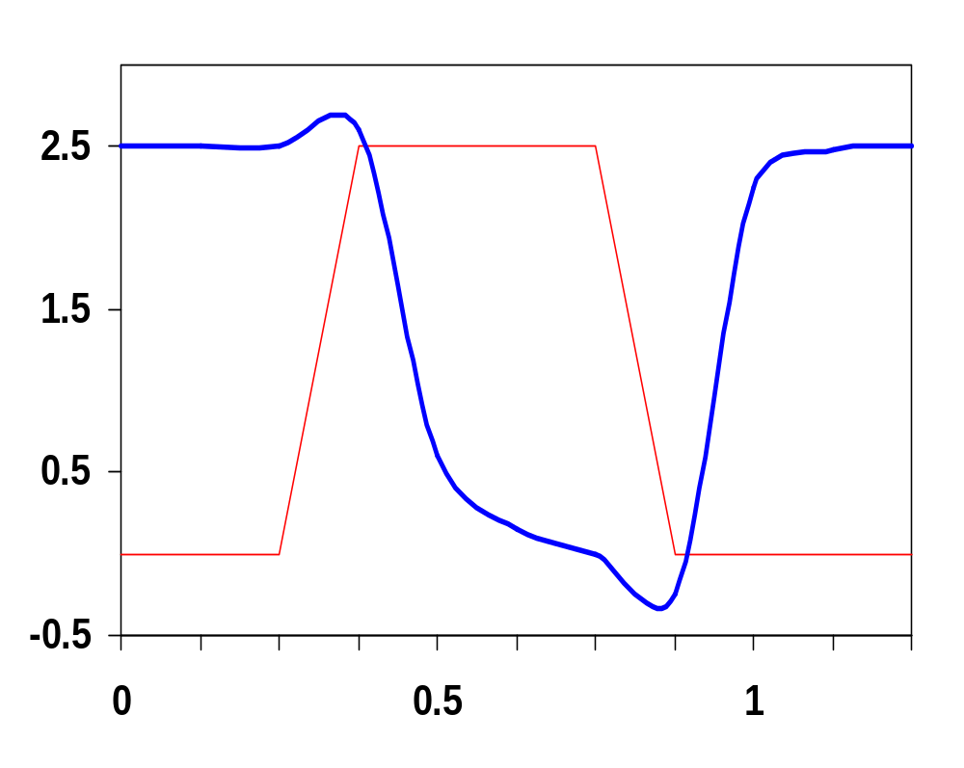
Dynamic Behavior
CLK
Out
Evaluate
In₁
In₂
Voltage
In₃
In &
CLK
In₄
Out
Precharge
CLK
Time, ns
#Trns | V_{OH} | V_{OL} | V_{M} | NM_{H} | NM_{L} | t_{pHL} | t_{pLH} | t_{p}
6 | 2.5V | 0V | V_{Tn} | 2.5-V_{Tn} | V_{Tn} | 110ps | 0ns | 83ps
Notes:
all data inputs set to 1.
The duration of the precharge cycle can be adjusted by changing the size of the PMOS precharge transistor. But making it too large increases the gate’s Cint as well as increasing the capacitive load on the clock.

Slide 13
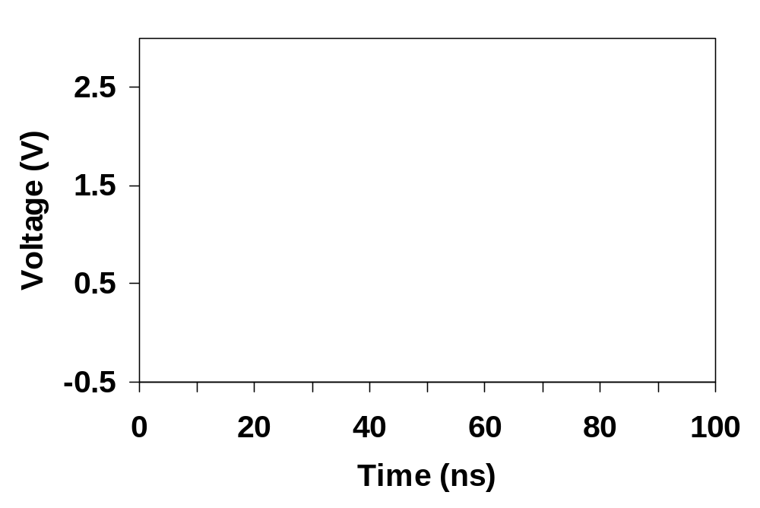
Gate Parameters are Time Independent
The amount by which the output voltage drops is a strong function of the input voltage and the available evaluation time.
  Noise needed to corrupt the signal has to be larger if the evaluation time is short – i.e., the switching threshold is truly time independent.
CLK
V_{out} (V_{G}=0.45)
V_{out} (V_{G}=0.55)
V_{out} (V_{G}=0.5)
V_{G}
Notes:
Plot shows the effect of an input glitch on the output. The switching threshold depends on the time for evaluation. A larger glitch (VG = 0.55) is acceptable if the evaluation phase is shorter

Slide 14
Power Consumption of Dynamic Gate
CLK
M_{p}
Out
In₁
C_{L}
In₂
PDN
In₃
CLK
M_{e}
Power only dissipated when previous Out = 0
Notes:
Evaluate transistor, Me, eliminates static power consumption
But what about clock power impact?

Slide 15
Dynamic Power Consumption is Data Dependent
Dynamic 2-input NOR Gate
Assume signal probabilities
P_{A=1} = 1/2
P_{B=1} = 1/2
A | B | Out
0 | 0 | 1
0 | 1 | 0
1 | 0 | 0
1 | 1 | 0
Then transition probability
P_{0→1} = P_{out=0} x P_{out=1}
= 3/4 x 1 = 3/4
Switching activity can be higher in dynamic gates!
P_{0→1} = P_{out=0}
Notes:
Assumes inputs of 0 and 1 are equally likely.
For dynamic gates, the activity depends only on the signal probability - while for the static case the transition probability depends on the previous state. Remember for static NOR gate P0->1 = 3/16

Slide 16
Issues in Dynamic Design 1: Charge Leakage
CLK
4
CLK
M_{p}
3
Out
1
A=0
C_{L}
2
Evaluate
V_{Out}
CLK
M_{e}
Precharge
Leakage sources
Minimum clock rate of a few kHz
Notes:
leakage sources are reverse-biased diode (1) and the sub-threshold leakage (2) of the NMOS pulldown device.
Charge stored on CL will leak away with time (input in low state during evaluation)
Requires a minimum clock rate - so not good for low performance products such as watches (or when have conditional clocks)
PMOS precharge device also contributes some leakage due to reverse bias diode (3) and subthreshold conduction (4) that, to some extent, offsets the leakage due to the pull down paths.

Slide 17
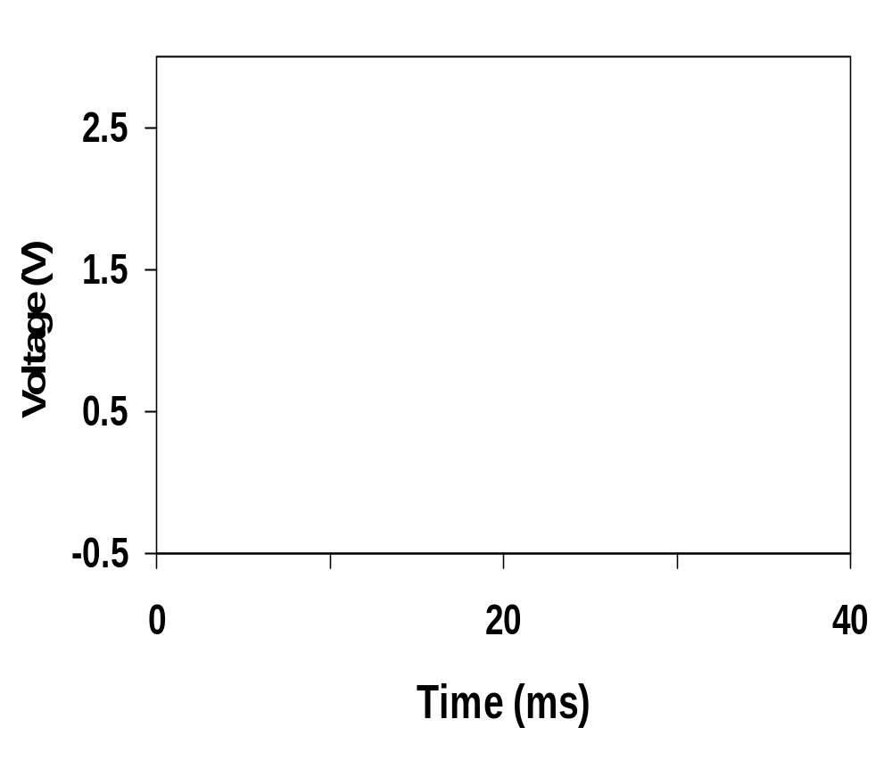
Impact of Charge Leakage
Output settles to an intermediate voltage determined by a resistive divider of the pull-up and pull-down networks
  Once the output drops below the switching threshold of the fan-out logic gate, the output is interpreted as a low voltage.
CLK
Out

Slide 18
A Solution to Charge Leakage
Keeper compensates for the charge lost due to the pull-down leakage paths.
Keeper
CLK
M_{p}
M_{kp}
!Out
A
C_{L}
B
CLK
M_{e}
Same approach as level restorer for pass transistor logic
Notes:
During precharge, Out is VDD and inverter out is GND, so keeper is on
During evaluation if PDN is off, the keeper compensates for drained charge due to leakage.
If PDN is on, there is a fight between the PDN and the PUN - circuit is ratioed so PDN wins, eventually
Note Psc during switching period when PDN and keeper are both on simultaneously

Slide 19
Issues in Dynamic Design 2: Charge Sharing
Charge stored originally on C_{L} is redistributed (shared) over C_{L} and C_{A} leading to static power consumption by downstream gates and possible circuit malfunction.
CLK
M_{p}
Out
A
C_{L}
B=0
C_{a}
CLK
M_{e}
C_{b}
When ΔV_{out} = - V_{DD} (C_{a} / (C_{a} + C_{L} )) the drop in V_{out} is large enough to be below the switching threshold of the gate it drives causing a malfunction.
Notes:
CA initially discharged and CL fully charged.

Slide 20
Charge Sharing Example
What is the worst case voltage drop on y? (Assume all inputs are low during precharge and that all internal nodes are initially at 0V.)
Load
inverter
CLK
y = A ⊕ B ⊕ C
A
!A
C_{y}=50fF
a
B
b
C_{a}=15fF
!B
B
!B
c
d
C_{b}=15fF
C_{c}=15fF
!C
C
C_{d}=10fF
CLK
Notes:
For class handout

Slide 21
Charge Sharing Example
What is the worst case voltage drop on y? (Assume all inputs are low during precharge and that all internal nodes are initially at 0V.)
Load
inverter
CLK
y = A ⊕ B ⊕ C
A
!A
C_{y}=50fF
a
B
b
C_{a}=15fF
!B
B
!B
c
d
C_{b}=15fF
C_{c}=15fF
!C
C
C_{d}=10fF
CLK
ΔV_{out} = - V_{DD} ((C_{a} + C_{c})/((C_{a} + C_{c}) + C_{y}))
= - 2.5V*(30/(30+50)) = -0.94V
Notes:
For lecture – should work up a different example than the one in the book (like just set the internal capacitances different)
Output stays high for 4 out of 8 cases (!A B C, !A !B !C, A !B C, and A B !C)
Worst case is obtained by exposing the maximum amount of internal capacitance to the output node during evaluation. This happens when !A B C or A !B C
30/(30+50) * 2.5 V = -0.94 V so the output drops to 2.5 - 0.94 = 1.56 V which is below the switching threshold of the Load inverter.

Slide 22
Solution to Charge Redistribution
CLK
M_{p}
M_{kp}
CLK
Out
A
B
CLK
M_{e}
Precharge internal nodes using a clock-driven transistor (at the cost of increased area and power)

Slide 23
Issues in Dynamic Design 3: Backgate Coupling
Susceptible to crosstalk due to 1) high impedance of the output node and 2) capacitive coupling
  Out2 capacitively couples with Out1 through the gate-source and gate-drain capacitances of M4
CLK
M_{p}
M₆
M₅
Out1
=1
Out2
=0
A=0
M₁
M₄
C_{L1}
C_{L2}
B=0
M₂
M₃
In
CLK
M_{e}
Dynamic NAND
Static NAND
Notes:
The high impedance of the output node makes the circuit very sensitive to crosstalk effects. A wire routed over or next to a dynamic node may couple capacitively and destroy the state of the floating node.
Due to capacitive backgate coupling between the internal and output node of the static gate and the output of the dynamic gate, Out1 voltage reduces

Slide 24
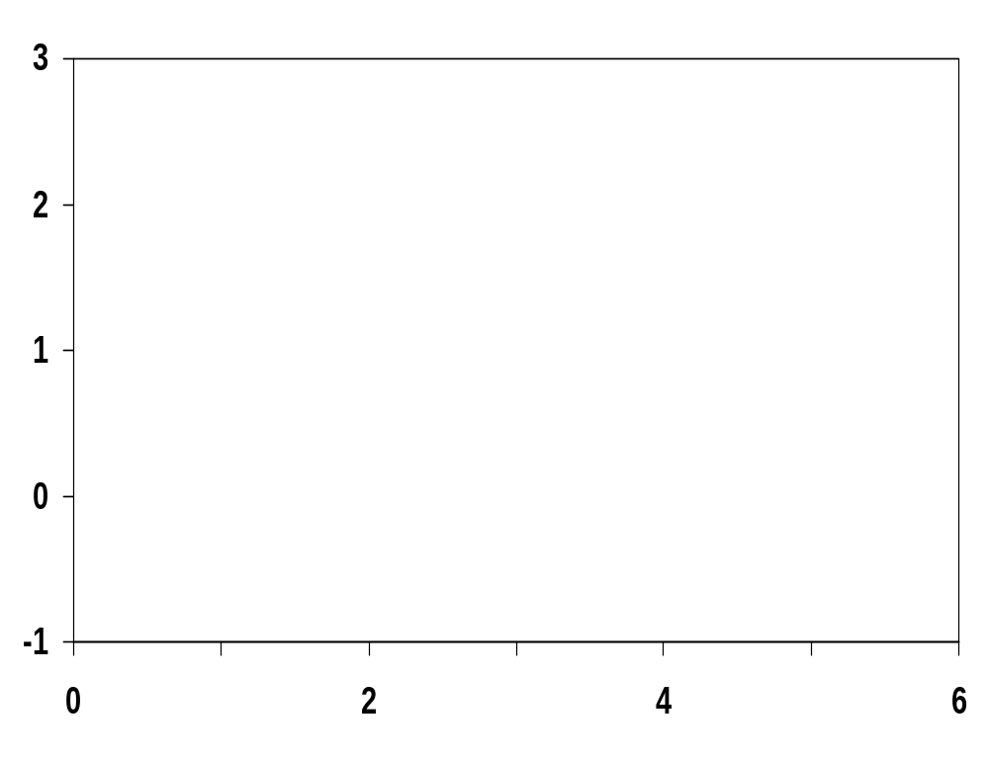
Backgate Coupling Effect
Capacitive coupling means Out1 drops significantly so Out2 doesn’t go all the way to ground
Out1
Voltage
CLK
In
Out2
Time, ns
Notes:
Out1 overshoots Vdd (2.5V) due to clock feedthrough
And Out2 never quite makes it to GND

Slide 25
Issues in Dynamic Design 4: Clock Feedthrough
A special case of capacitive coupling between the clock input of the precharge transistor and the dynamic output node
Coupling between Out and CLK input of the precharge device due to the gate- drain capacitance. So voltage of Out can rise above V_{DD}. The fast rising (and falling edges) of the clock couple to Out.
CLK
M_{p}
Out
A
C_{L}
B
CLK
M_{e}
Notes:
Danger is that signal levels can rise enough above VDD that the normally reverse-biased junction diodes become forward-biased causing electrons to be injected into the substrate.

Slide 26
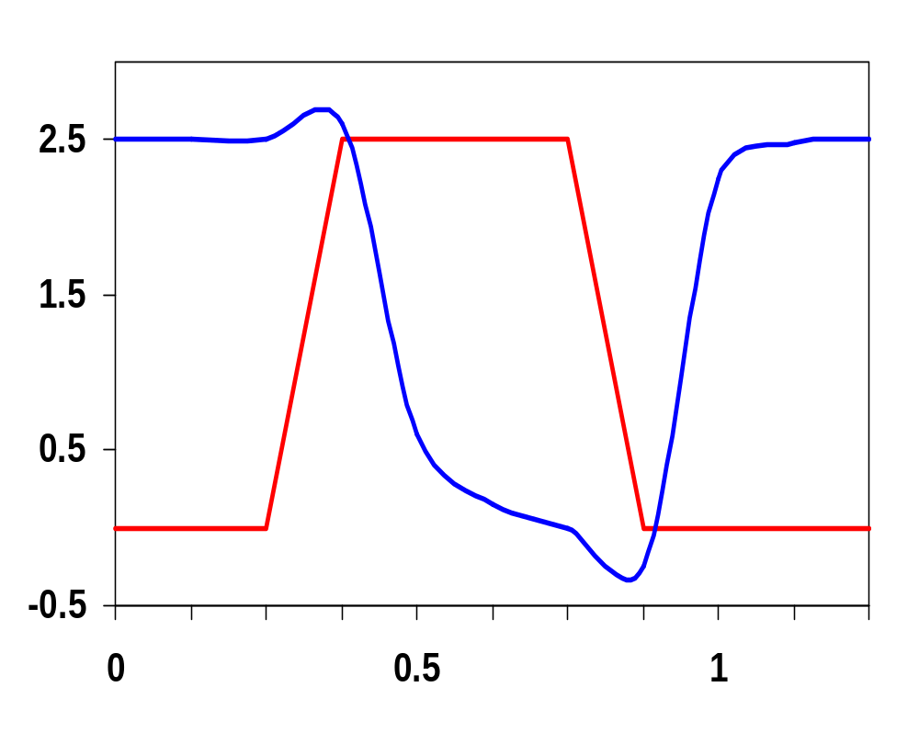
Clock Feedthrough
CLK
Clock feedthrough
Out
In₁
In₂
In₃
Voltage
In &
CLK
In₄
CLK
Out
Time, ns
Clock feedthrough

Slide 27
Cascading Dynamic Gates
V
CLK
CLK
CLK
M_{p}
M_{p}
Out2
Out1
In
In
V_{Tn}
Out1
CLK
M_{e}
CLK
M_{e}
ΔV
Out2
t
Only a single 0 → 1 transition allowed at the inputs during the evaluation period!
Notes:
Out2 should remain at VDD since Out1 transitions to 0 during evaluation. However, since there is a finite propagation delay for the input to discharge Out1 to GND, the second output also starts to discharge.
The second dynamic inverter turns off (PDN) when Out1 reaches VTn.
Setting all inputs of the second gate to 0 during precharge will fix it.
Correct operation is guaranteed (ignoring charge redistribution and leakage) as long as the inputs can only make a single 0 -> 1 transition during the evaluation period

Slide 28
Domino Logic
CLK
M_{p}
CLK
M_{p}
M_{kp}
Out1
Out2
1 → 1
1 → 0
0 → 0
0 → 1
In₁
In₂
PDN
In₄
PDN
In₃
In₅
CLK
M_{e}
CLK
M_{e}
Notes:
Ensures all inputs to the Domino gate are set to 0 at the end of the precharge period. Hence, the only possible transition during evaluation is 0 -> 1
Additional advantage is that the fan-out of the gate is driven by a static inverter with a low-impedance output that increases the noise immunity.
The buffer also reduces the capacitance of the dynamic output node by separating internal and load capacitances.
Finally, the inverter can be used to drive a bleeder to combat leakage and charge redistribution.

Slide 29
Why Domino?
CLK
In₁
In_{i}
PDN
In_{i}
PDN
In_{i}
PDN
In_{i}
PDN
In_{j}
In_{j}
In_{j}
In_{j}
CLK
Like falling dominos!

Slide 30
Domino Manchester Carry Chain
CLK
P₀
P₁
P₂
P₃
C_{i,4}
C_{i,0}
G₀
G₁
G₂
G₃
CLK
Notes:
For class handout.

Slide 31
Domino Manchester Carry Chain
CLK
3 3 3 3 3
P₀
P₁
P₂
P₃
4
3
2
1
C_{i,4}
C_{i,0}
5
6
G₀
4
5
G₁
3
4
G₂
2
3
G₃
1
2
CLK
!(G₀ + P₀ C_{i,0})
!(G₁ + P₁G₀ + P₁P₀ C_{i,0})
Notes:
For lecture.
Note four pass transistors in series (P3 P2 P1 P0) + Ci,0 and Me of first gate.
Automatically forms all the intermediate carries as well – as shown on animation
Sizing assumes only integer multiples allowed, should pfets all be 3?

Slide 32
Domino Zero Detector
In₇
In₆
In₅
In₄
In₃
In₂
In₁
In₀
not zero
CLK
Notes:
Slide hidden – to be used as the basis of a question for the final exam.
How would you build it in static CMOS? A 16-wide fan-in OR function using a tree composed of NAND and NOR gates
As opposed to one dynamic gate!

Slide 33
Domino Comparator
A3
A2
A1
A0
CLK
Out
B3
B2
B1
B0
Notes:
4 bit comparator, out is miscompare (1 when they are not equal)
AND function in each NMOS pull-down stack.
AND-NOR structure appears in many interesting dynamic control circuits.
Don’t need isolation fet in the pull-down, since the bottom NMOS fet is forced off during precharge.

Slide 34
Properties of Domino Logic
Only non-inverting logic can be implemented, fixes include
  can reorganize the logic using Boolean transformations
  use differential logic (dual rail)
  use np-CMOS (zipper)
Very high speed
  t_{pHL} = 0
  static inverter can be optimized to match fan-out (separation of fan-in and fan-out capacitances)
Notes:
First 32 bit micro (BellMAC 32) was designed in Domino logic
Now a rather rare design style due to non-inverting logic only

Slide 35
Differential (Dual Rail) Domino
off
on
CLK
M_{p}
M_{kp}
M_{kp}
M_{p}
CLK
1 0
1 0
!Out = !(AB)
Out = AB
A
!A
!B
B
CLK
M_{e}
Due to its high-performance, differential domino is very popular and is used in several commercial microprocessors!
Notes:
AND/NAND differential logic gate. The inputs and their complements come from other differential DR gates and thus all inputs are low during precharge and make a conditional transition from 0 to 1. Annotations show state during evaluate cycle (CLK = 1)
Expensive - but can implement any arbitrary function.
Use significant power since they have a guaranteed transition every single clock cycle (regardless of signal statistics, since either Out or !Out will transition from 0 to 1).
Not ratioed (even though have a cross-coupled PMOS pair)
Need to add slides on the optimization of domino logic gates (pages 283-285, Figure 6.68 and 6.69)

Slide 36
np-CMOS (Zipper)
CLK
M_{p}
!CLK
M_{e}
Out1
1 → 1
1 → 0
In₁
In₄
PUN
In₂
PDN
In₅
In₃
0 → 0
0 → 1
Out2
(to PDN)
CLK
M_{e}
!CLK
M_{p}
to other
PDN’s
to other
PUN’s
Only 0 → 1 transitions allowed at inputs of PDN Only 1 → 0 transitions allowed at inputs of PUN
Notes:
Also called zipper logic and NORA (no race) logic - In4 and In5 must be from PDN’s
DEC alpha uses np-CMOS logic (Dobberpuhl)
Have to size the PUN’s to equalize the delay to that of the PDN’s
Really dense layouts and very high speed (20% faster than domino with the correct sizing)
Reduced noise margin (as with any dynamic gate)
Have two clock signals to generate and route - CLK and !CLK

Slide 37
np-CMOS Adder Circuit
!CLK
CLK
1 → x
0 → x
Sum₁
!A₁
!B₁
!B₁
!C₁
1 → x
!A₁
!B₁
!C₁
!A₁
!A₁
!B₁
!CLK
0 → x
C₂
CLK
!CLK
CLK
1 → x
!C₁
B₀
0 → x
A₀
B₀
C₀
A₀
A₀
A₀
B₀
B₀
1 → x
C₀
!Sum₀
C₀
CLK
!CLK
0 → x
Notes:
As shown in book. Why doesn’t this work??? (PDN wants only 0 -> X and PUN wants only 1 -> X and note that !C1 feeds not only the PUN of the next ms adder (legally), but also the PDN of the next ms adder (illegally).) Can you fix it?
How big/fast/power is it compared to a static implementation?
What are the conditions on the inputs (A0, B0 and Ci0)?

Slide 38
DCVS Logic
on
off
1
0
Out
!Out
In₁
!In₁
PDN1
PDN2
In₂
off
on
!In₂
PDN1 and PDN2 are mutually exclusive
Notes:
For class handout.
Not dynamic - but last logic style to cover - Differential Cascade Voltage Switch Logic
When PDN1 is conducting, PDN2 is off and vice versa, so are implementing a logic function and its inverse.
Note that the complement of every signal is needed - but the logic style provides it automatically. Also have reduced CL on outputs (driving only a PDN) but have to have both the signal and its complement
PDN1 must be strong enough to bring Out down to Vdd - Vtn (in spite of its pull up being on) so it can turn on the pull up of PDN2,
so both outputs can flip

Slide 39
DCVS Logic
on
→ off
off
→ on
1
→ 0
0
→ 1
Out
!Out
In₁
!In₁
PDN1
PDN2
In₂
off
→ on
on
→ off
!In₂
PDN1 and PDN2 are mutually exclusive
Notes:
For lecture.
Not dynamic - but last logic style to cover - Differential Cascade Voltage Switch Logic
When PDN1 is conducting, PDN2 is off and vice versa, so are implementing a logic function and its inverse.
Note that the complement of every signal is needed - but the logic style provides it automatically. Also have reduced CL on outputs (driving only a PDN) but have to have both the signal and its complement
PDN1 must be strong enough to bring Out down to Vdd - Vtn (in spite of its pull up being on) so it can turn on the pull up of PDN2,
so both outputs can flip

Slide 40
DCVSL Example
!Out
Out
B
!B
!B
B
A
!A
Notes:
What is it? (XOR-XNOR gate in only 8 transistors as opposed to 10 in comp static)
Note that the pull down has taken advantage of duplicated logic to share it and reduce the number of transistors in the pull down network from 8 to 6.
Sizing critical to functionality in PUN. Also has increased power dissipation due to short circuit current.
Very widely used due to its high performance

Slide 41
How to Choose a Logic Style
Must consider ease of design, robustness (noise immunity), area, speed, power, system clocking requirements, fan-out, functionality, ease of testing
4-input NAND
Style | # Trans | Ease | Ratioed? | Delay | Power
Comp Static | 8 | 1 | no | 3 | 1
CPL* | 12 + 2 | 2 | no | 4 | 3
domino | 6 + 2 | 4 | no | 2 | 2 + clk
DCVSL* | 10 | 3 | yes | 1 | 4
* Dual Rail
Current trend is towards an increased use of complementary static CMOS: design support through DA tools, robust, more amenable to voltage scaling.
Notes:
Current trend is towards an increased use of complementary static CMOS - tools driven that emphasis optimization at the logic level rather than the circuit level and that put a premium on robustness.
Static CMOS is also more amenable to voltage scaling than some of the other approaches.

Slide 42
Next Lecture and Reminders
Next lecture
  Timing metrics, static sequential circuits
    Reading assignment – Rabaey, et al, 7.1-7.2
Reminders
  Project prototypes due October 29th
  HW4 due October 31st
  Final exam scheduled
    Monday, December 16th from 10:10 to noon in TBD

